Slide 1
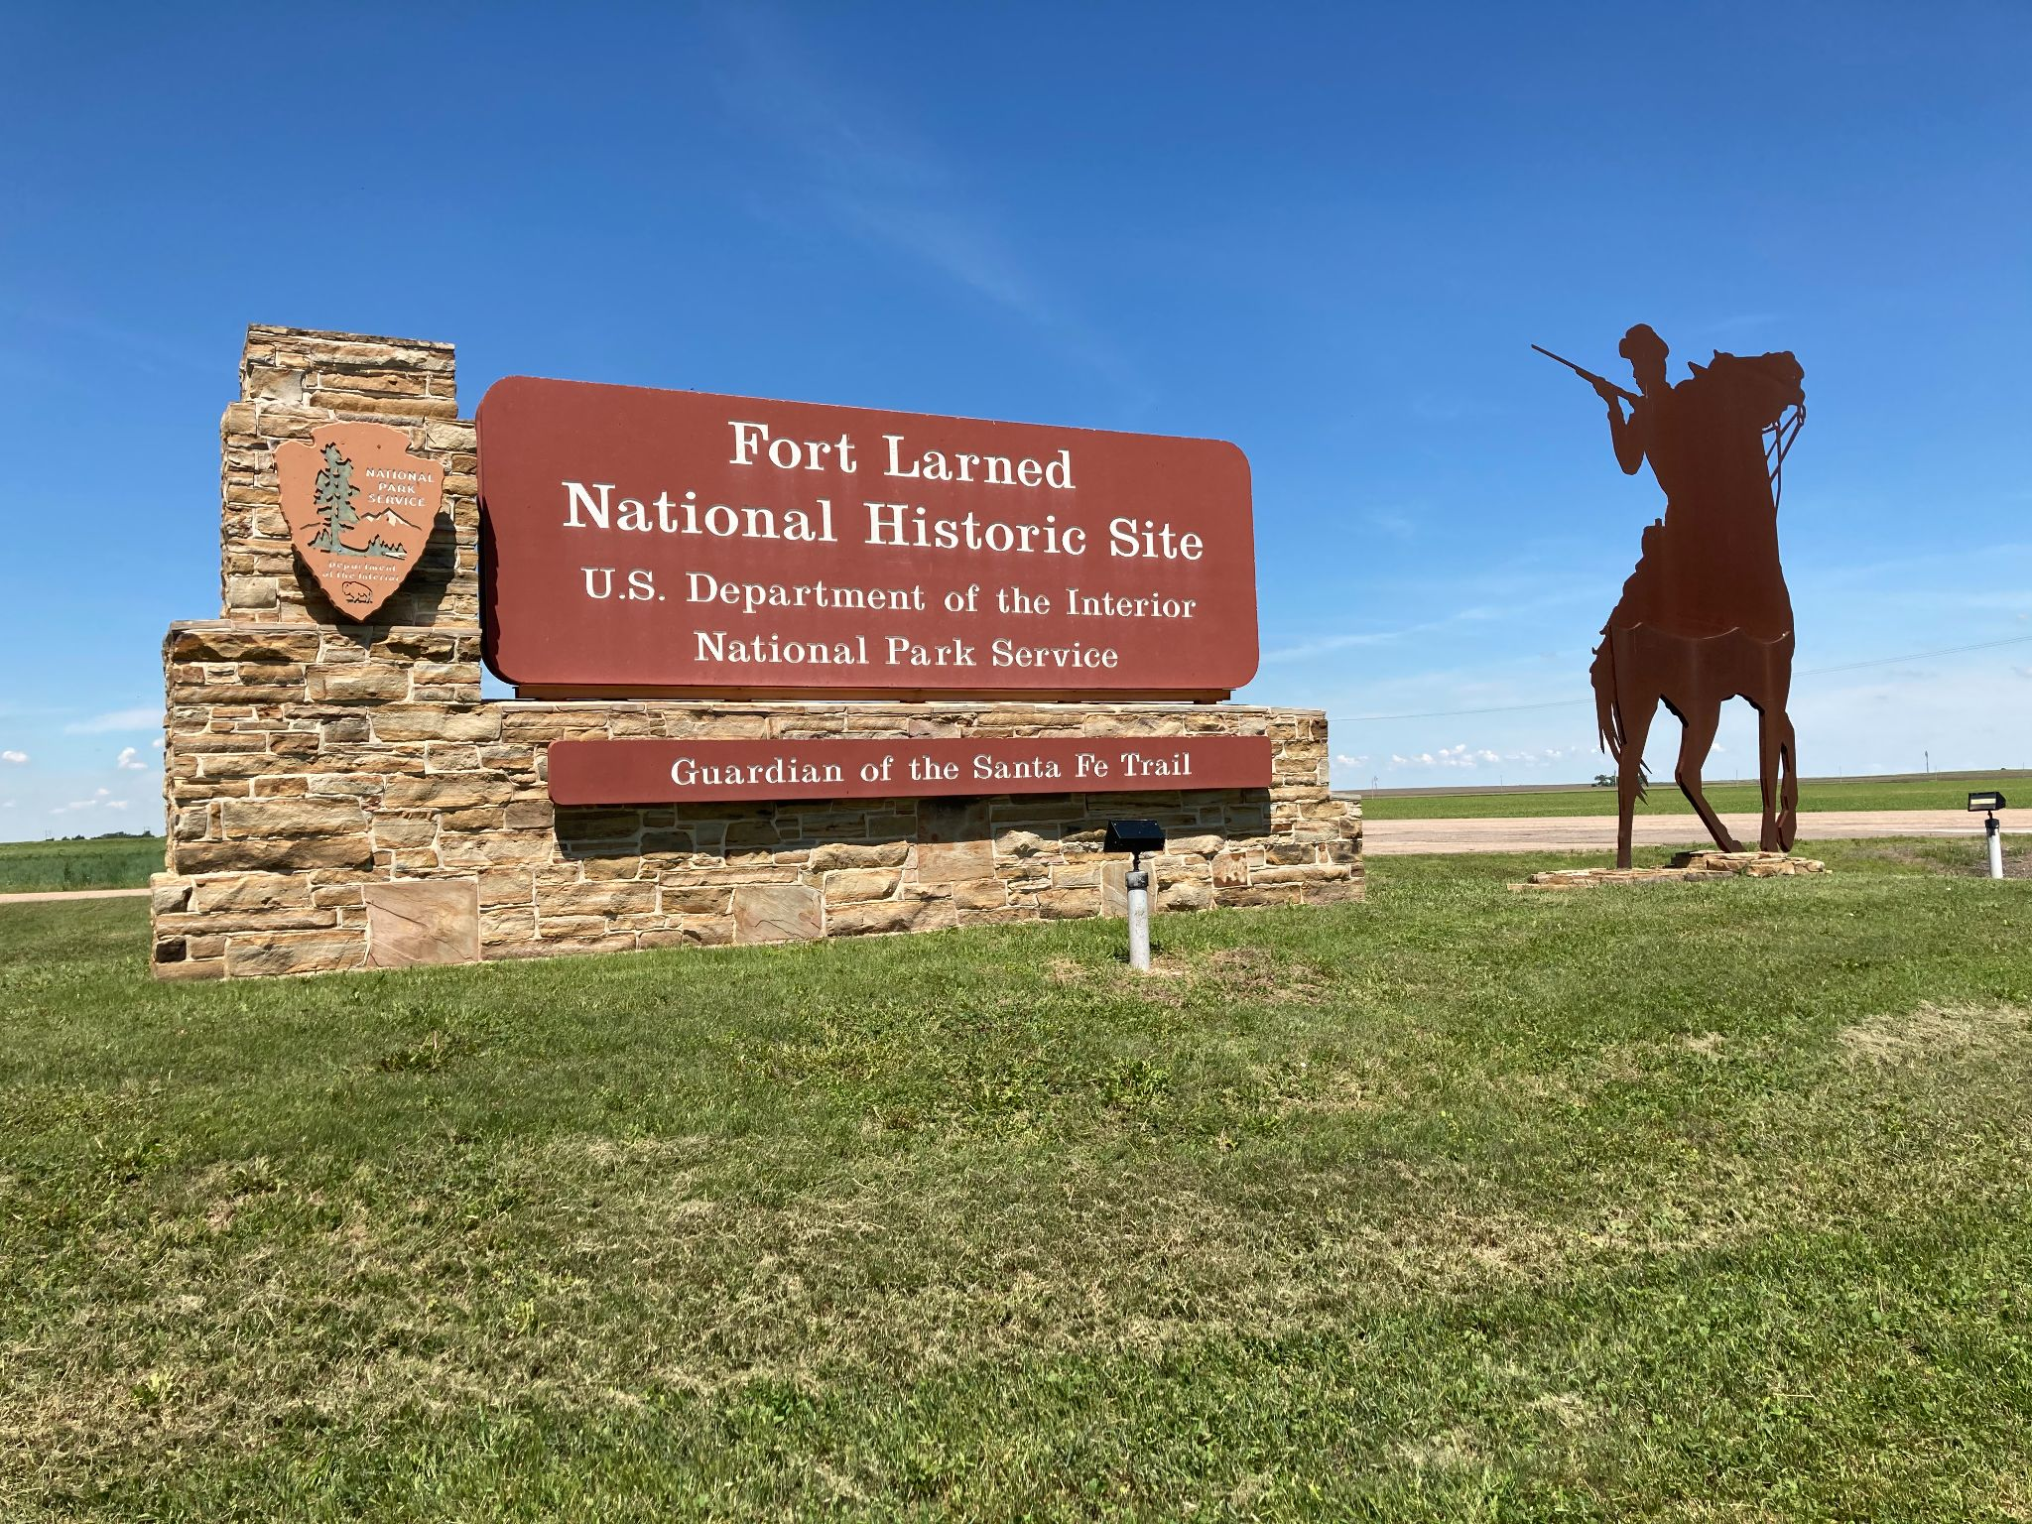
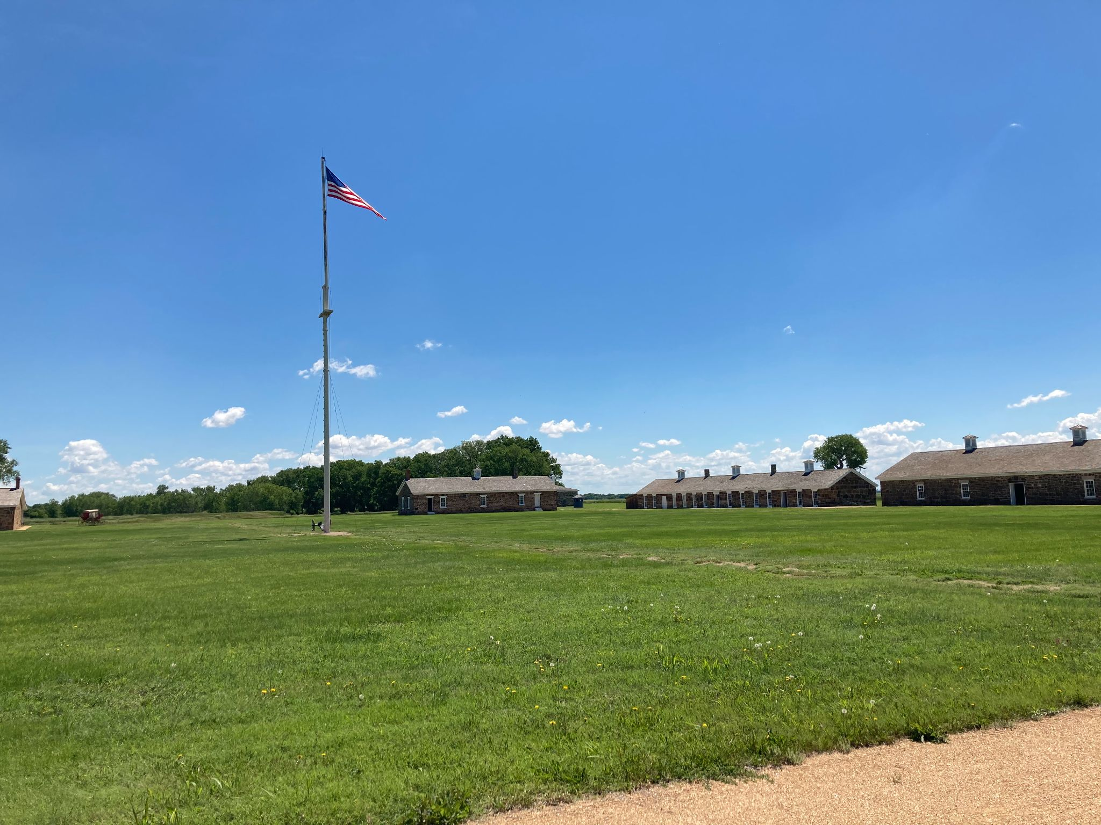
Fort Larned Overview
Created by Aaron Lentner, Teacher Ranger Teacher, 2021

Slide 2
Timeline of Fort Larned
1859: Fort Larned is established.
1865-1868: Fort takes on the role as Indian agency- distributing food and supplies.
1866-1868: Construction of the sandstone buildings that still stand today.
1872: Soldiers protect area railroad workers.
1878: The Army deactivates the fort.
1884: The fort is sold to private buyers.
1966: The fort is purchased by National Park Service.

Slide 3
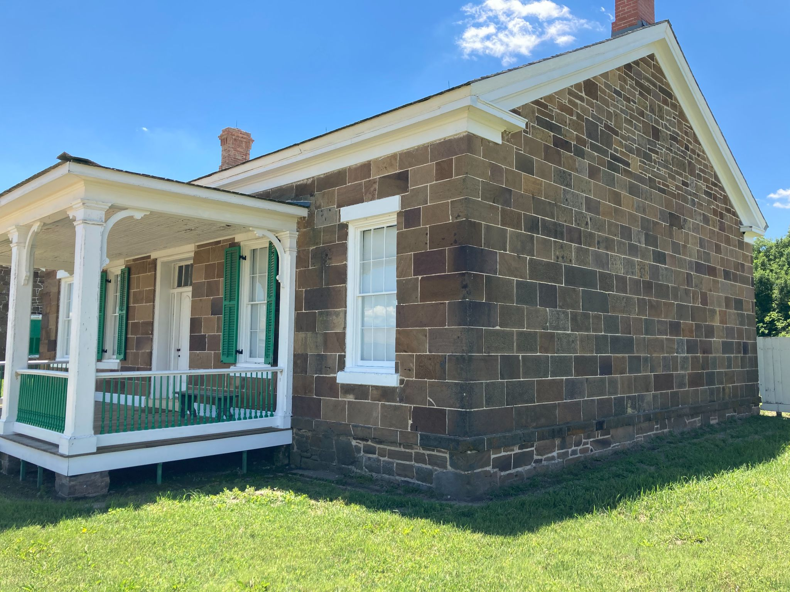
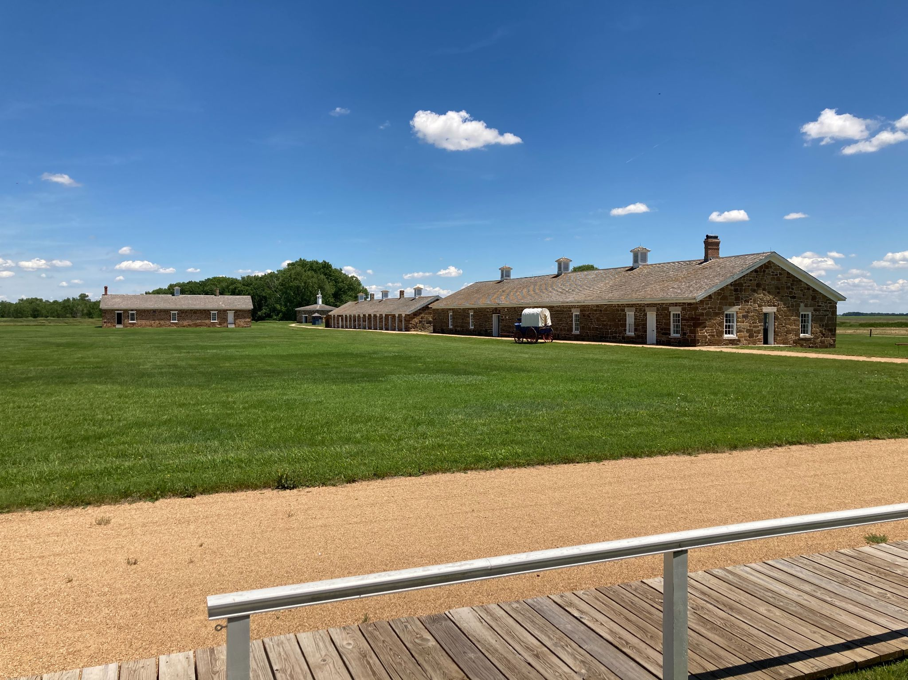
Historical Significance
Fort Larned is home to the “Guardians of the Santa Fe Trail.” This remote outpost was an important part of Santa Fe Trail history, involving many diverse groups of people.
Fort Larned is recognized as the best preserved example of a Indian wars military fort on the Santa Fe Trail. Nine of the original sandstone buildings can be seen by visitor’s today

Slide 4
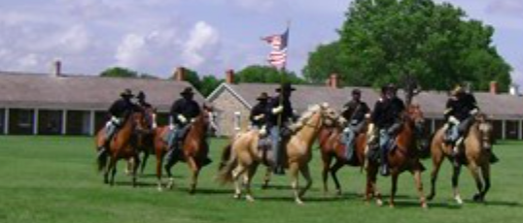
Cultural Significance
Many cultures mixed at Fort Larned. The soldiers at the fort interacted with Plains Indians, European American and Hispanic teamsters, homesteaders, hide hunters, scouts, and railroad workers. The fort also became home to the Buffalo Soldiers, the black soldiers who made up Company A of the 10th Cavalry.

Slide 5
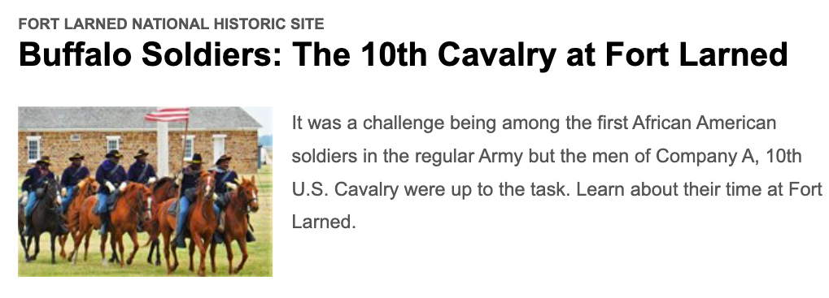
Fort Larned Today
Today, Fort Larned welcomes thousands of visitors each year. Visitors come to enjoy the buildings, tours, artifacts, demonstrations, and reenactments.
Many school groups come to enjoy the fort as well. Over the last year, many distance learning activities have been put into place.

Slide 6
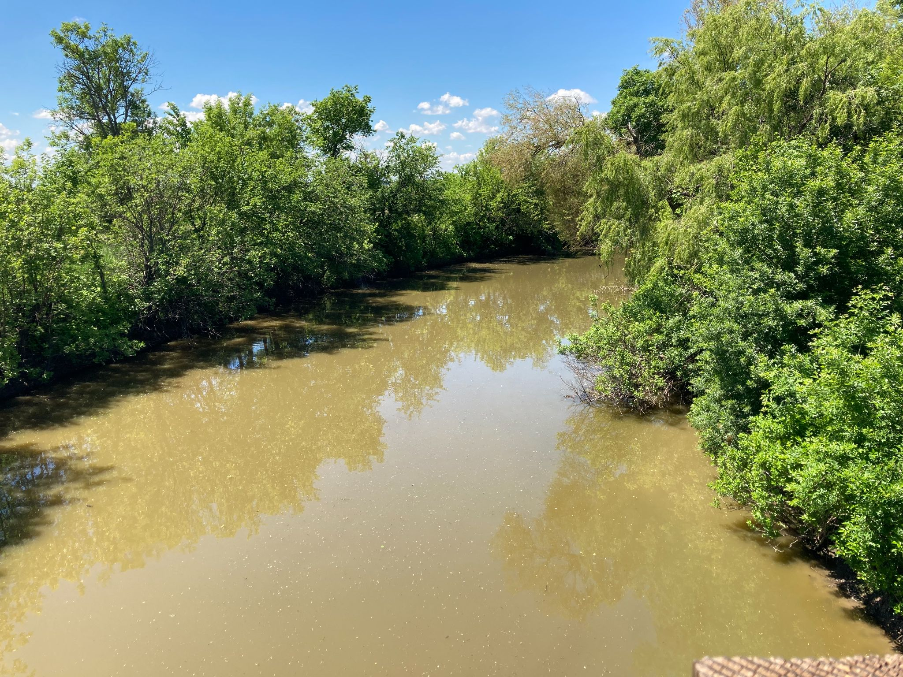
Fort Larned Today
The parks offers many different avenues for visitors to enjoy. This includes touring the buildings, hiking on the scenic nature trail, exploring the museum, and more!

Slide 7
Buildings / Grounds
Today there are ten sandstone buildings at Fort Larned.
Barracks (2 structures)- The visitor center and museum is located here as well.
Shops (1)
Blockhouse (1)
New Commissary (1)
Old Commissary (1)
Quartermaster storehouse (1)
Officers’ Quarters (3)

Slide 8
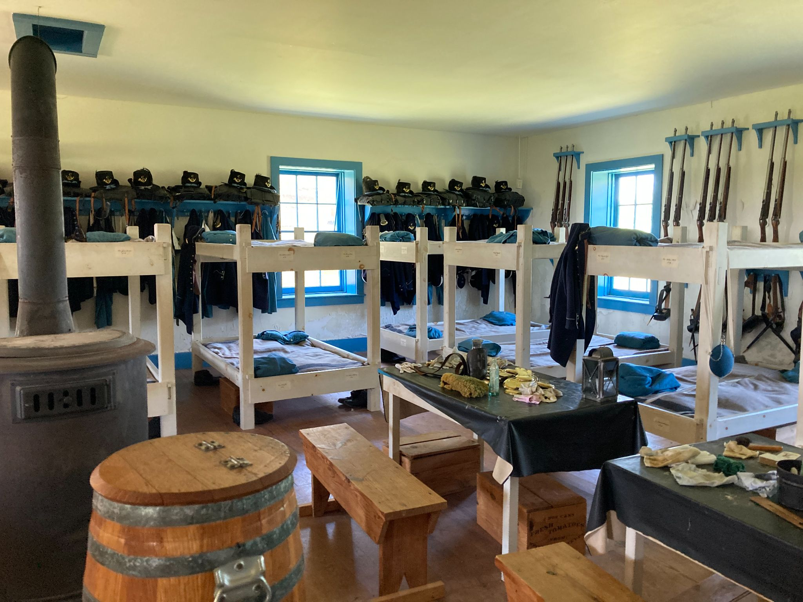
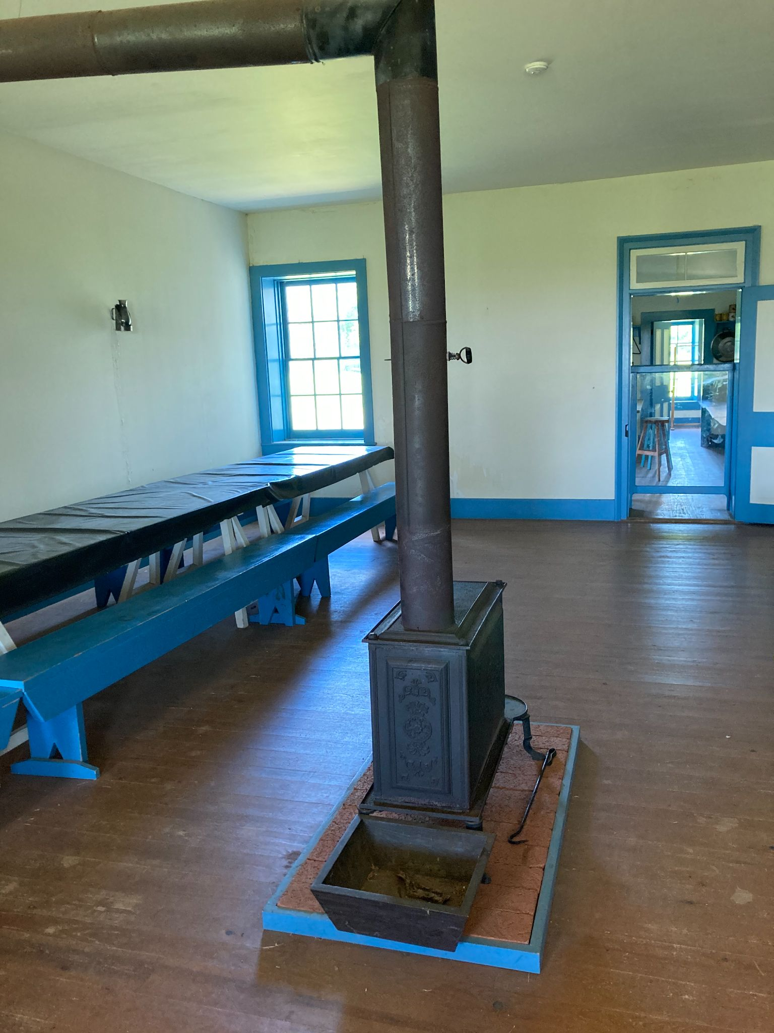
Barracks
There are two barracks buildings at Fort Larned. Each building included living quarters, mess halls, and kitchens. In 1871, part of the eastern barracks was converted into a hospital. Today, the western barracks building houses the visitor center and museum.
Living Quarters
Mess Hall

Slide 9
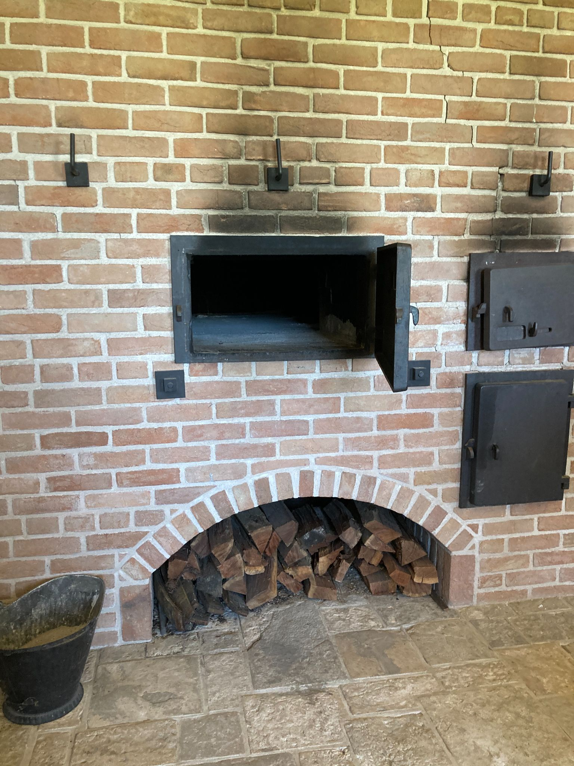
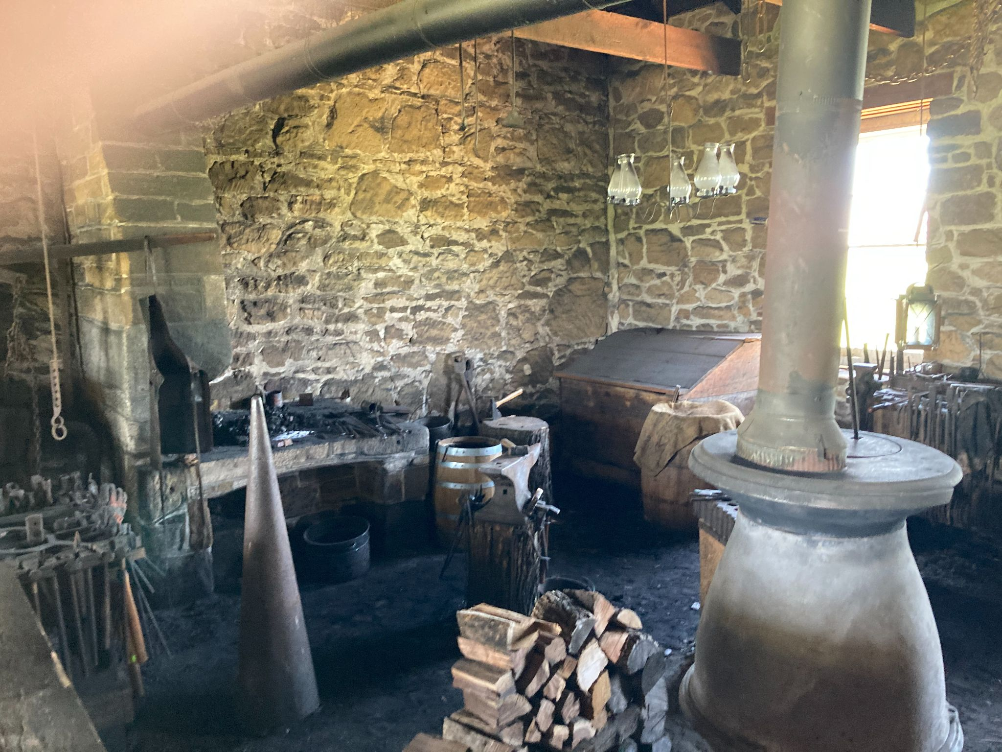
Shops
The shops building housed a bakery, carpentry shop, and blacksmith shop. Today, visitors can still find a blacksmith working in the shop.
Bakery oven- Could hold up to 300 loaves at a time!
Blacksmith Shop

Slide 10
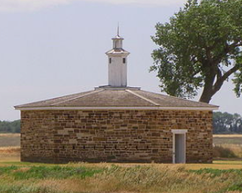
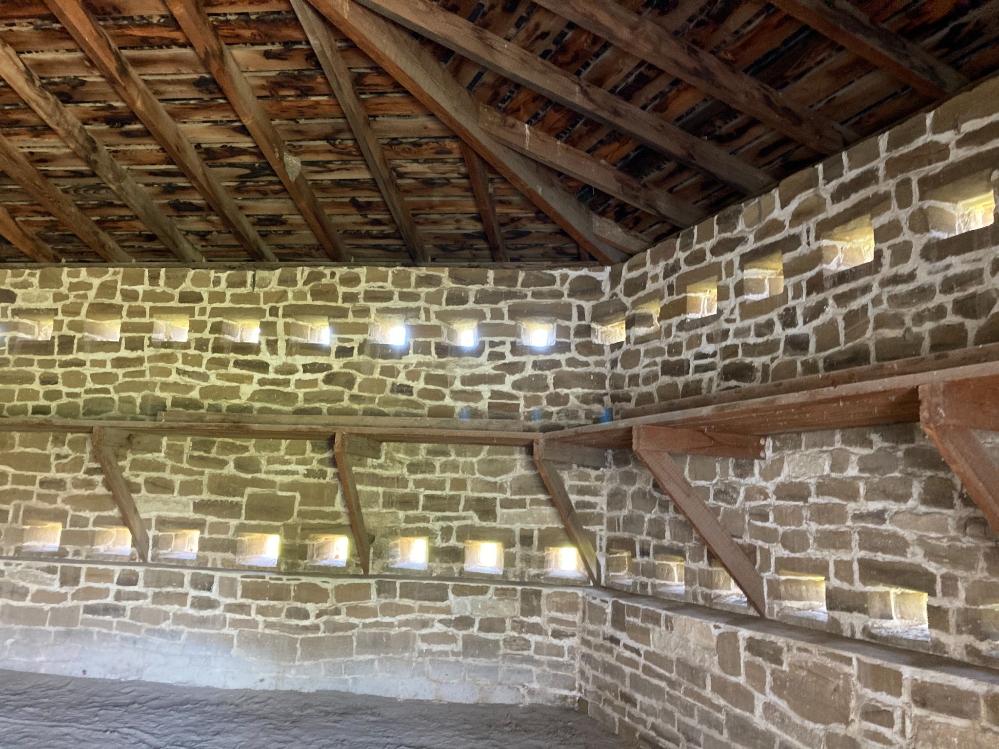
Blockhouse
This was originally built as a defensive structure in case of an Indian attack. It was later converted into a makeshift prison.
Blockhouse
Rifle Loopholes

Slide 11
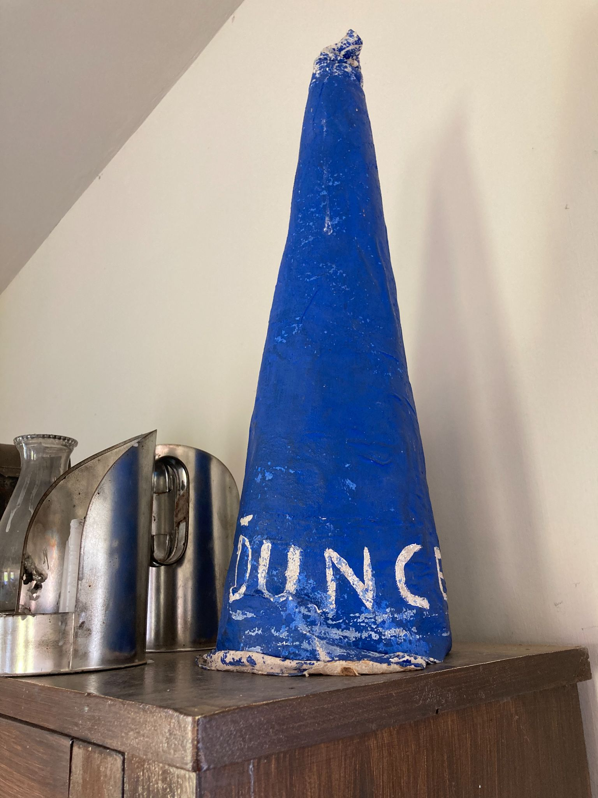
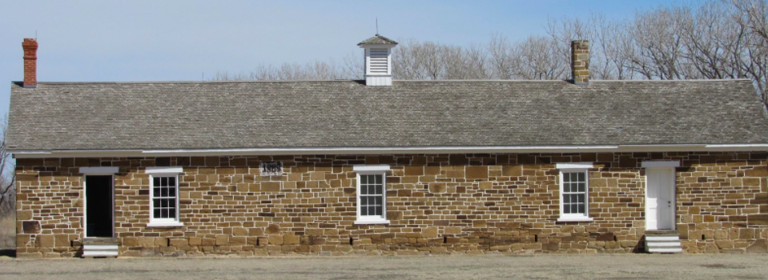
New Commissary and School
When the fort was at its peak, more space was needed for supplies and the New Commissary was built. In 1871, part of the building was converted into a school and library.
Dunce Cap- A symbol of the past!

Slide 12
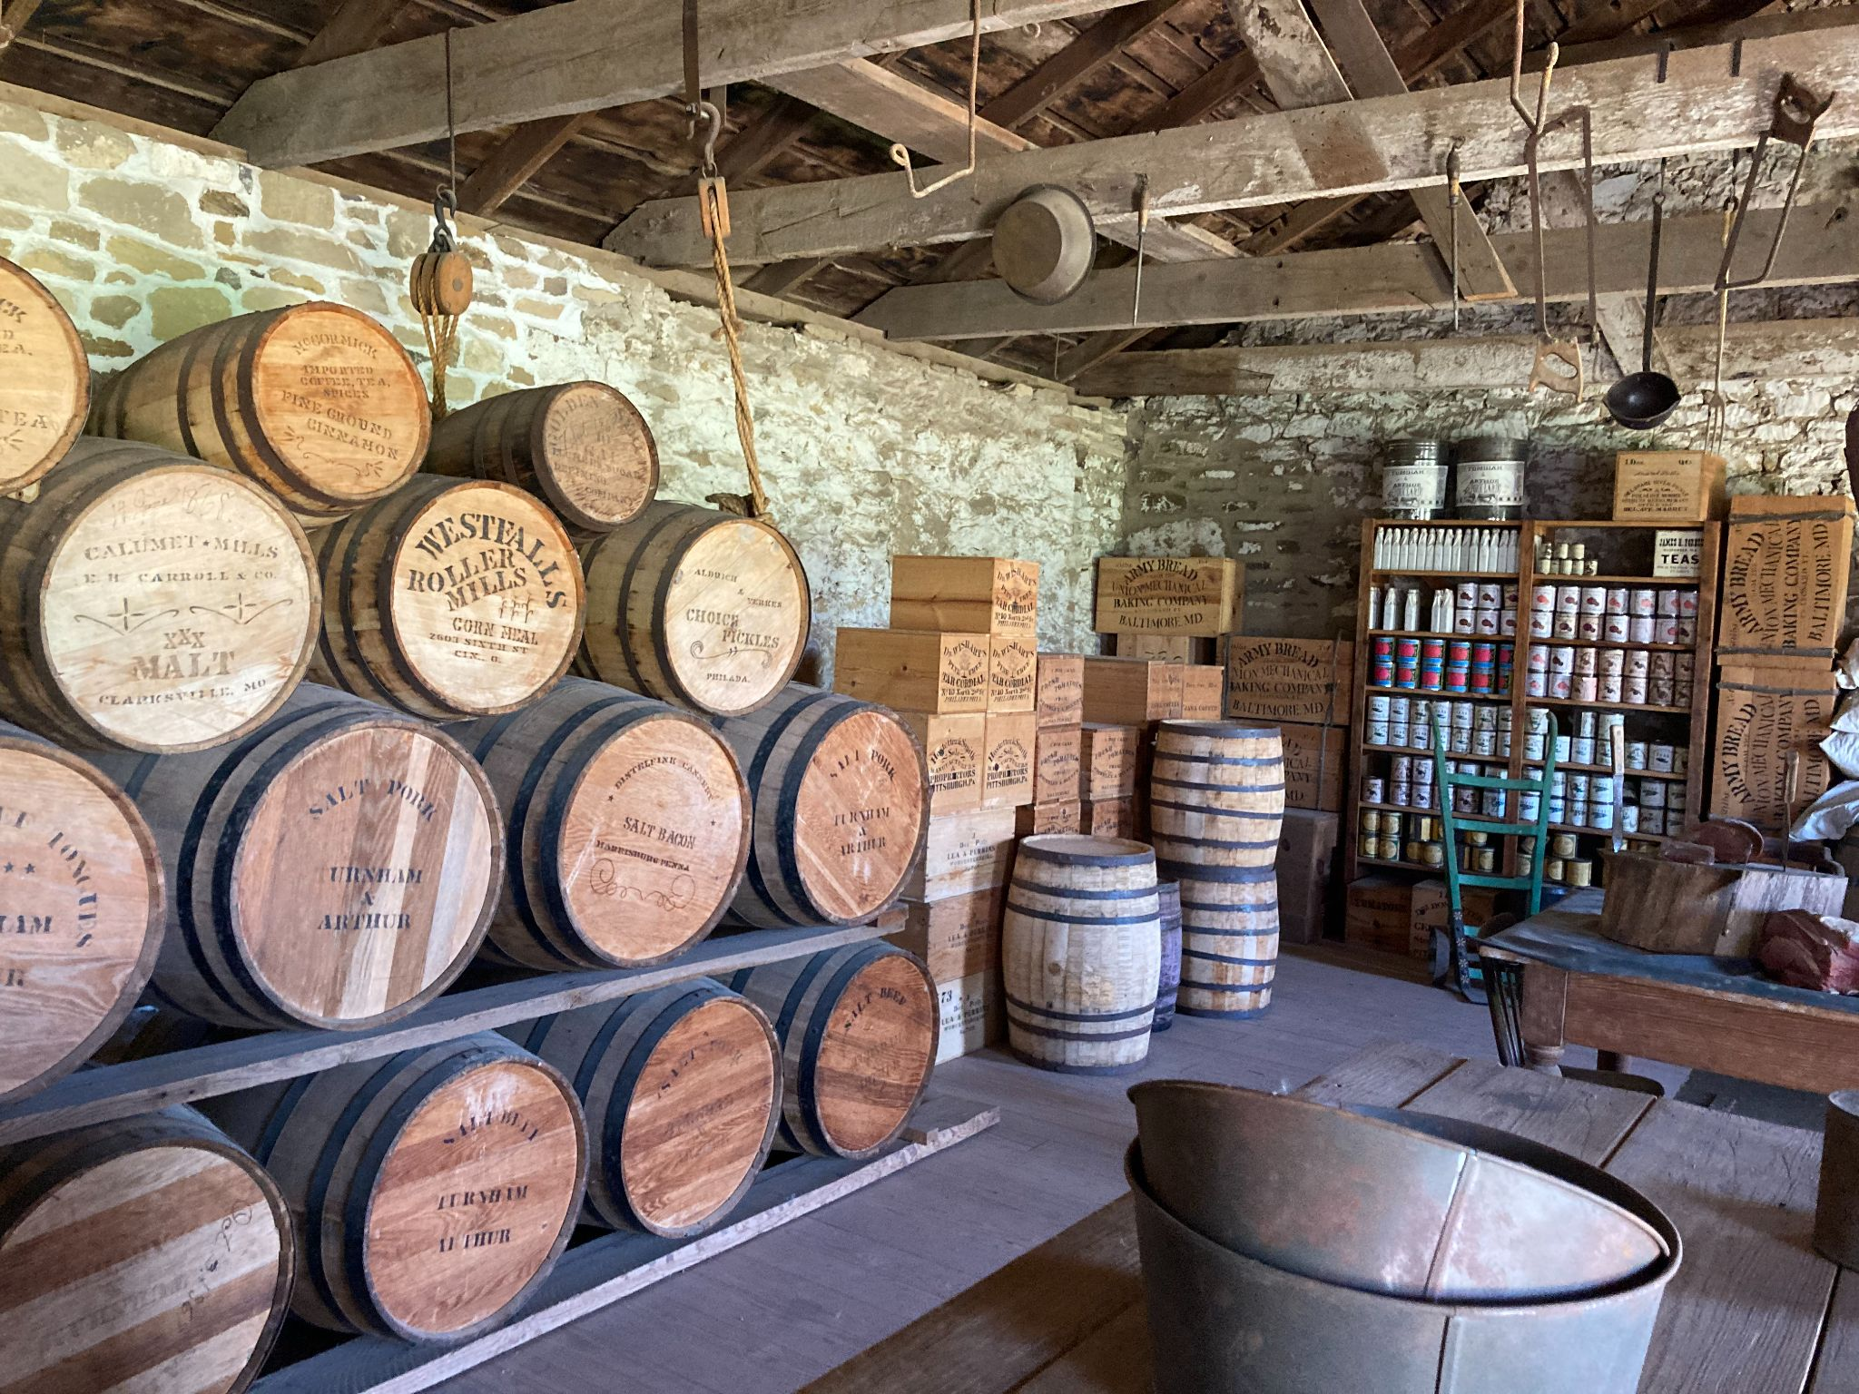
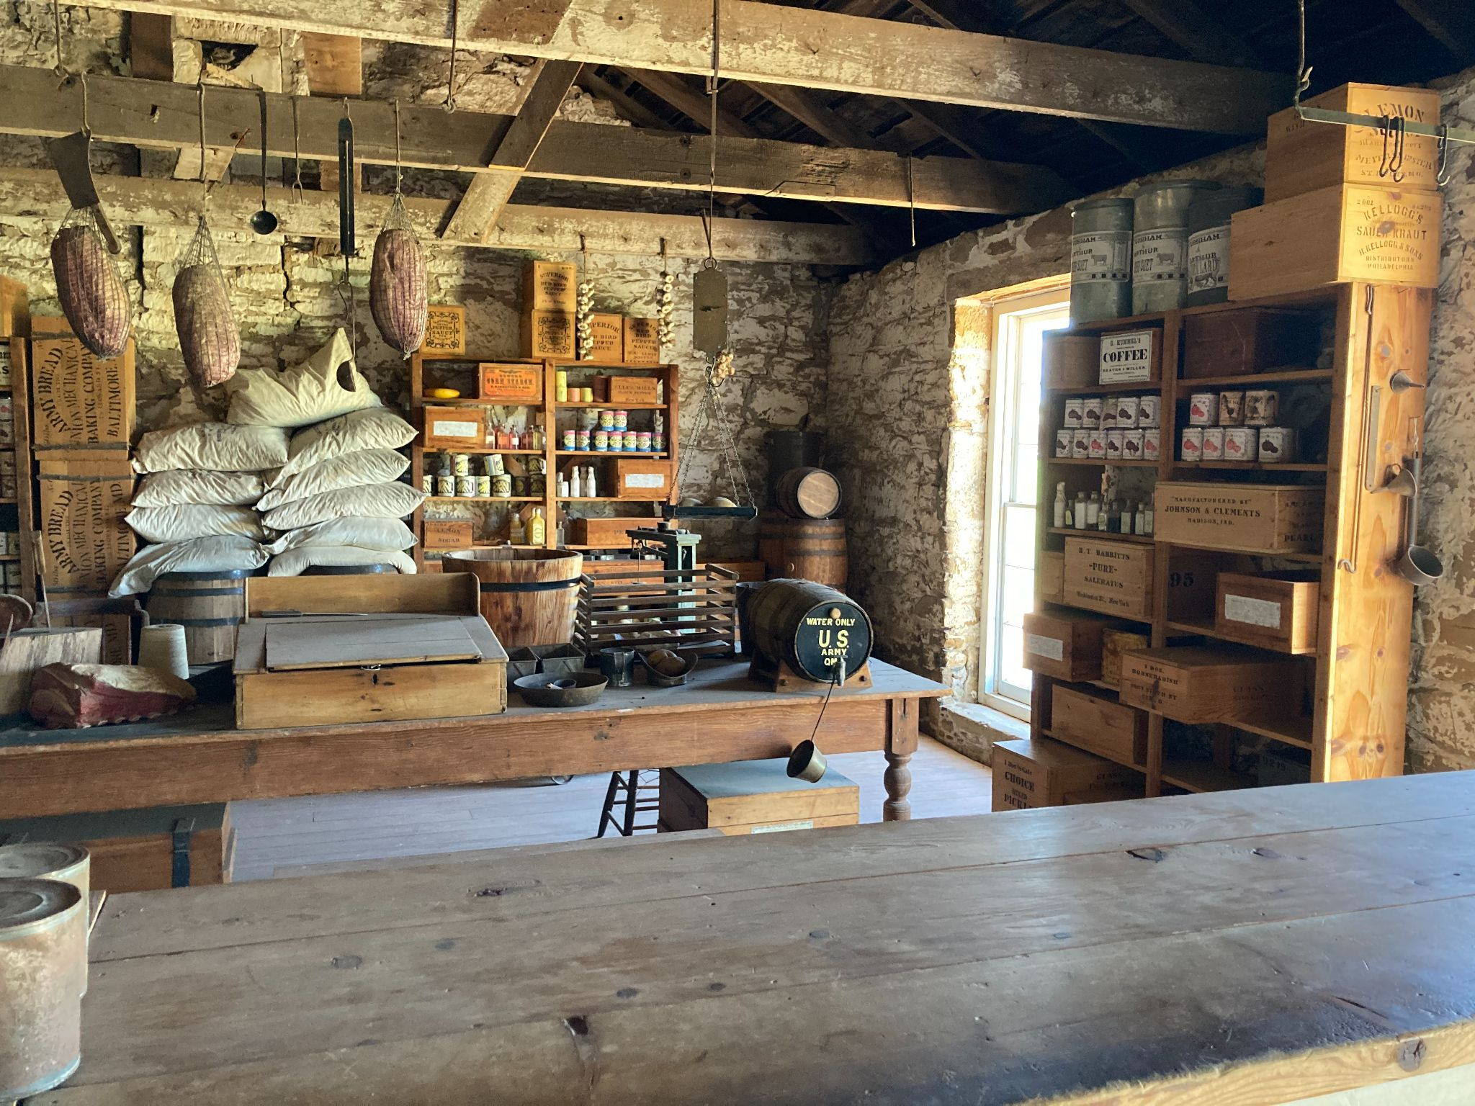
Old Commissary
This building was used to store food supplies to distribute daily rations. At best, the food supply at Fort Larned left a little to be desired.
Food Storage
Ingredients

Slide 13
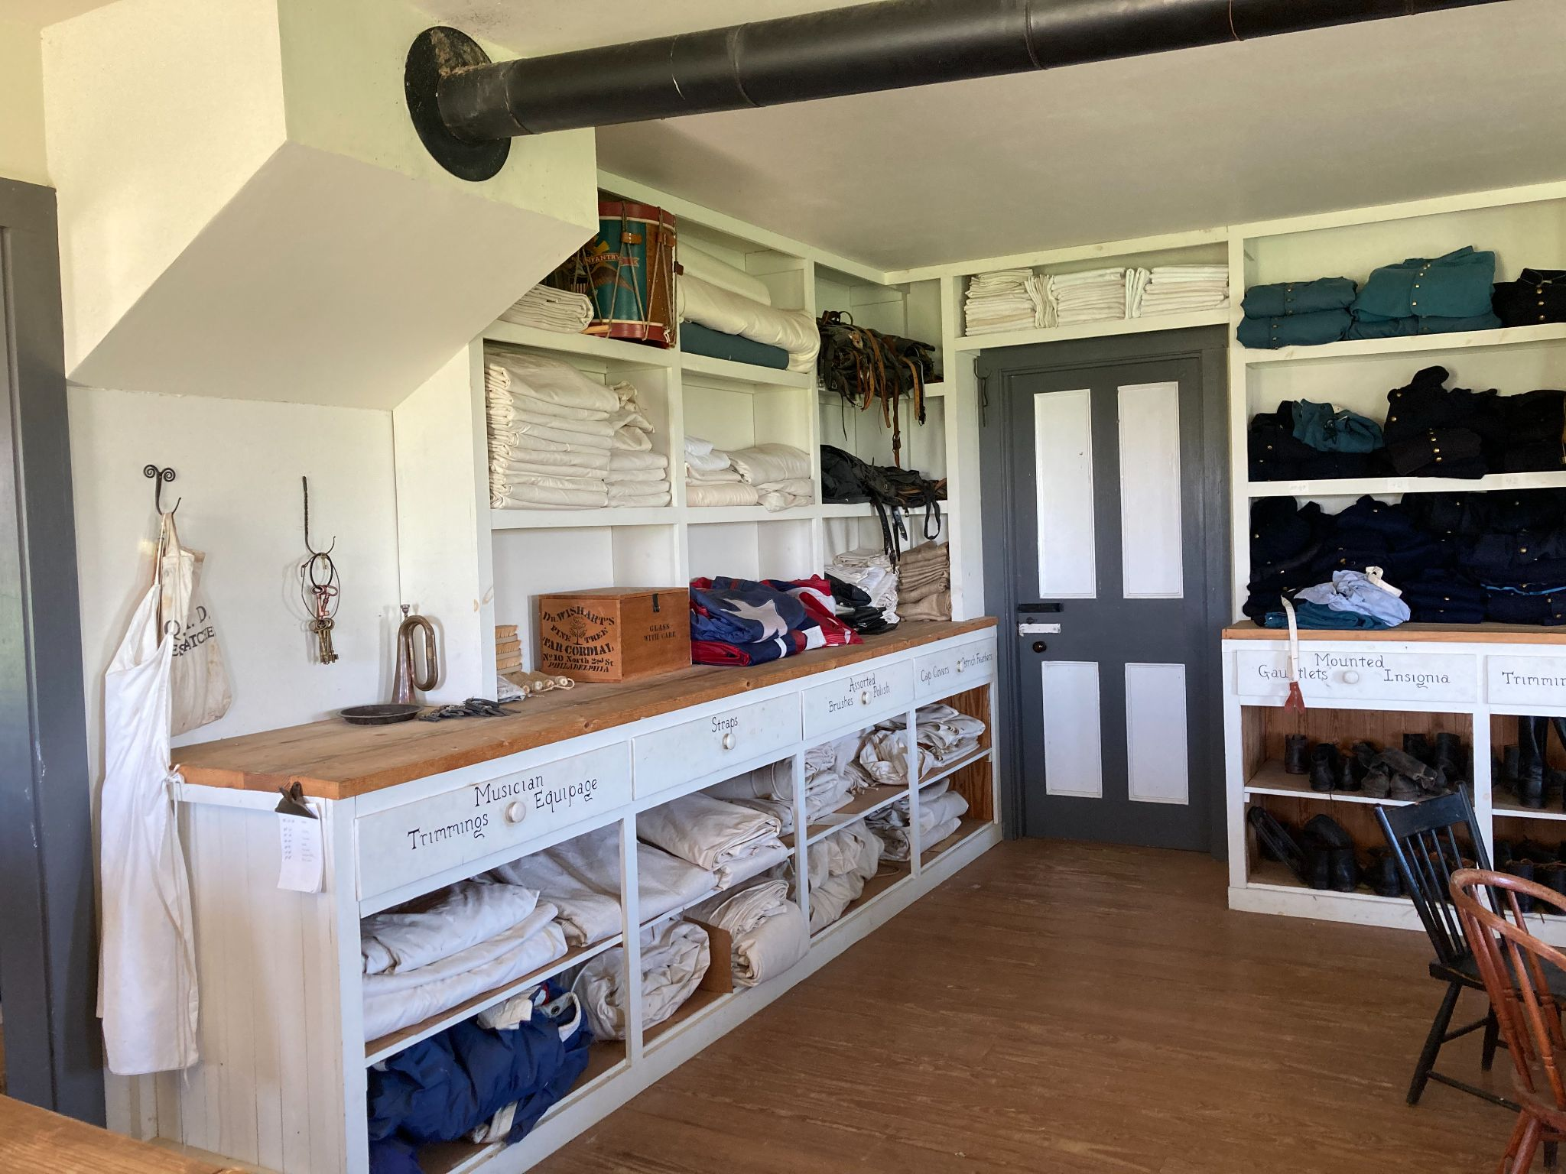
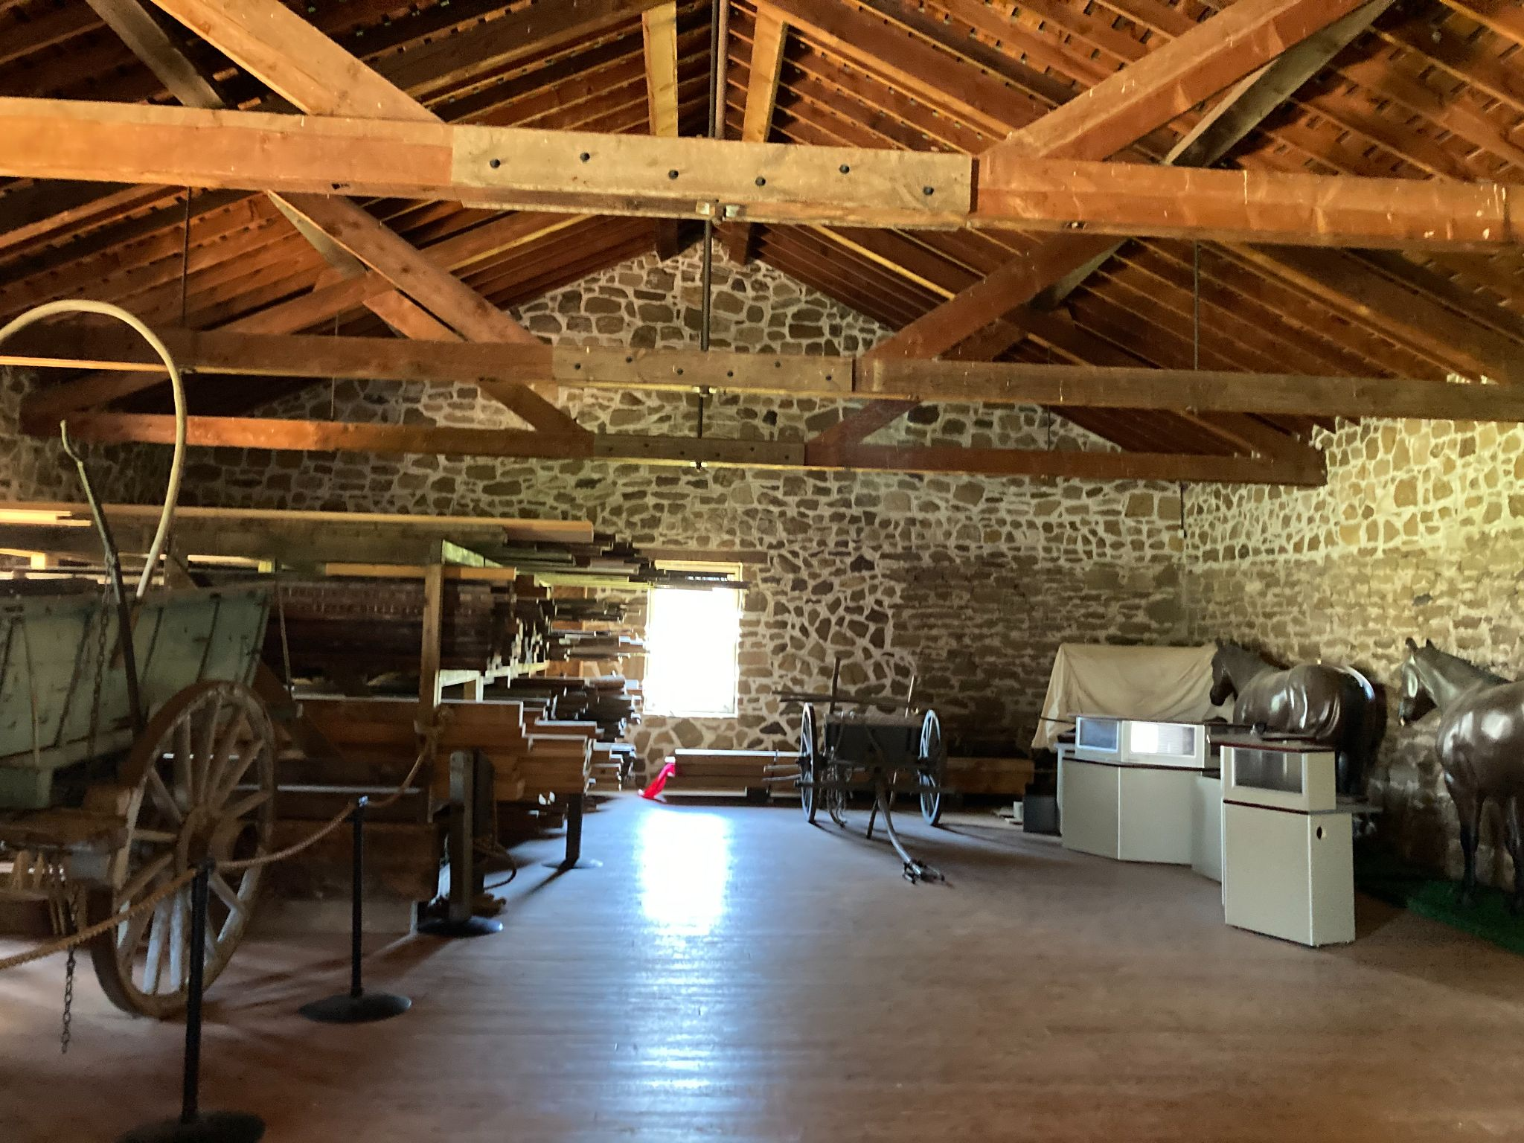
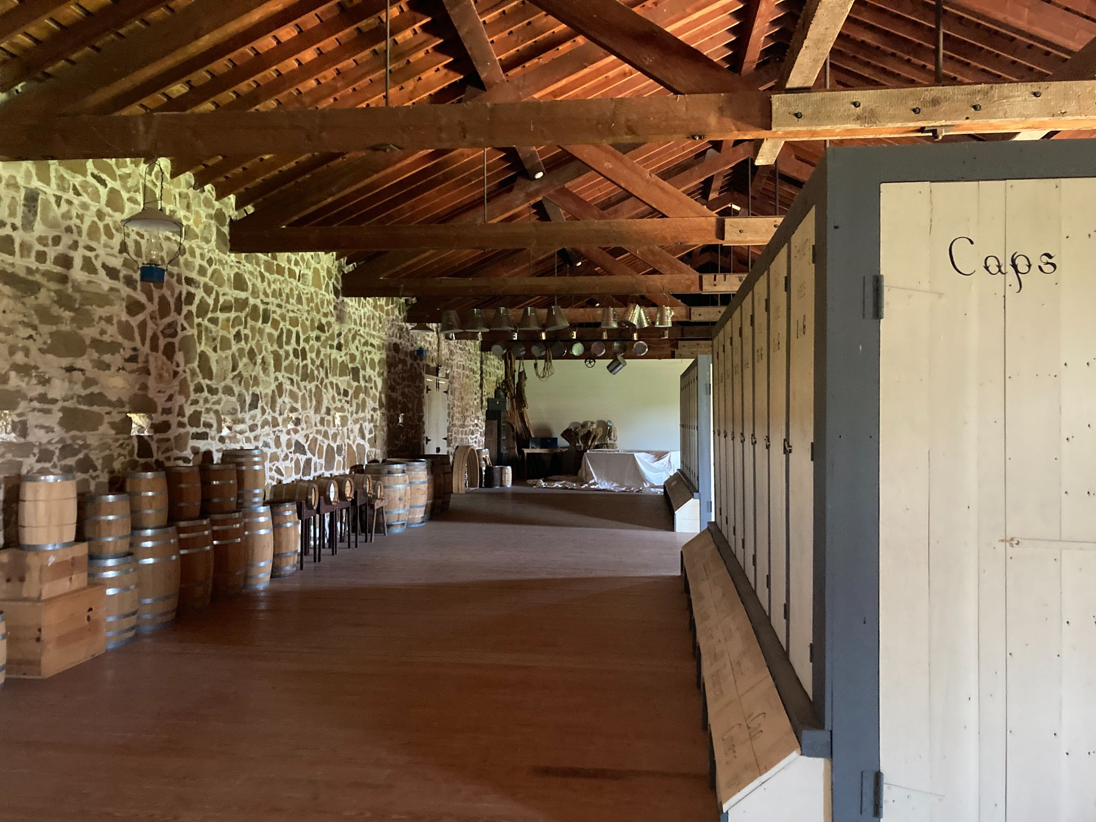
Quartermaster Storehouse
This building was used as a warehouse. It stored bedding, tools, uniform pieces, and much more. This is the largest building at the fort. Common soldiers would not be allowed the warehouse in order to keep everything secure. They would pick up supplies in the issue room.
Issue Room
Storehouse

Slide 14
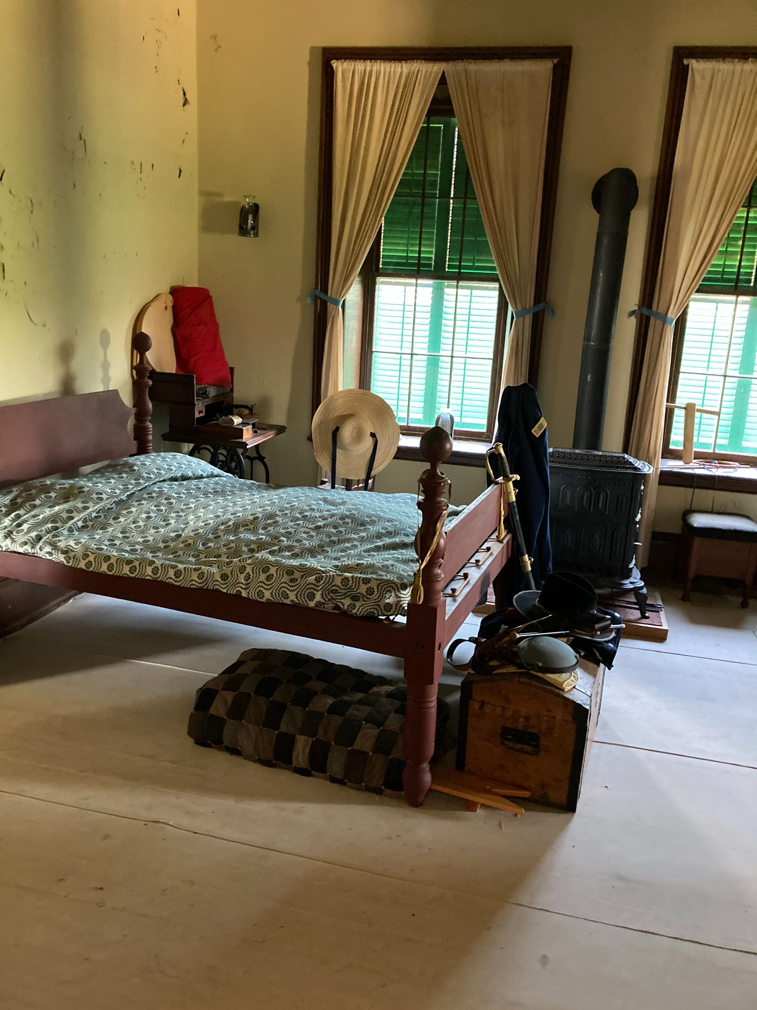
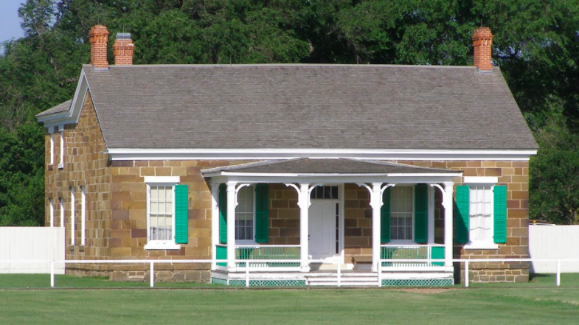
Officer’s Row
Commissioned officers had their own private living areas. There are 3 sandstone buildings on this row.
Commanding Officer’s Quarters
Officer Private Space

Slide 15
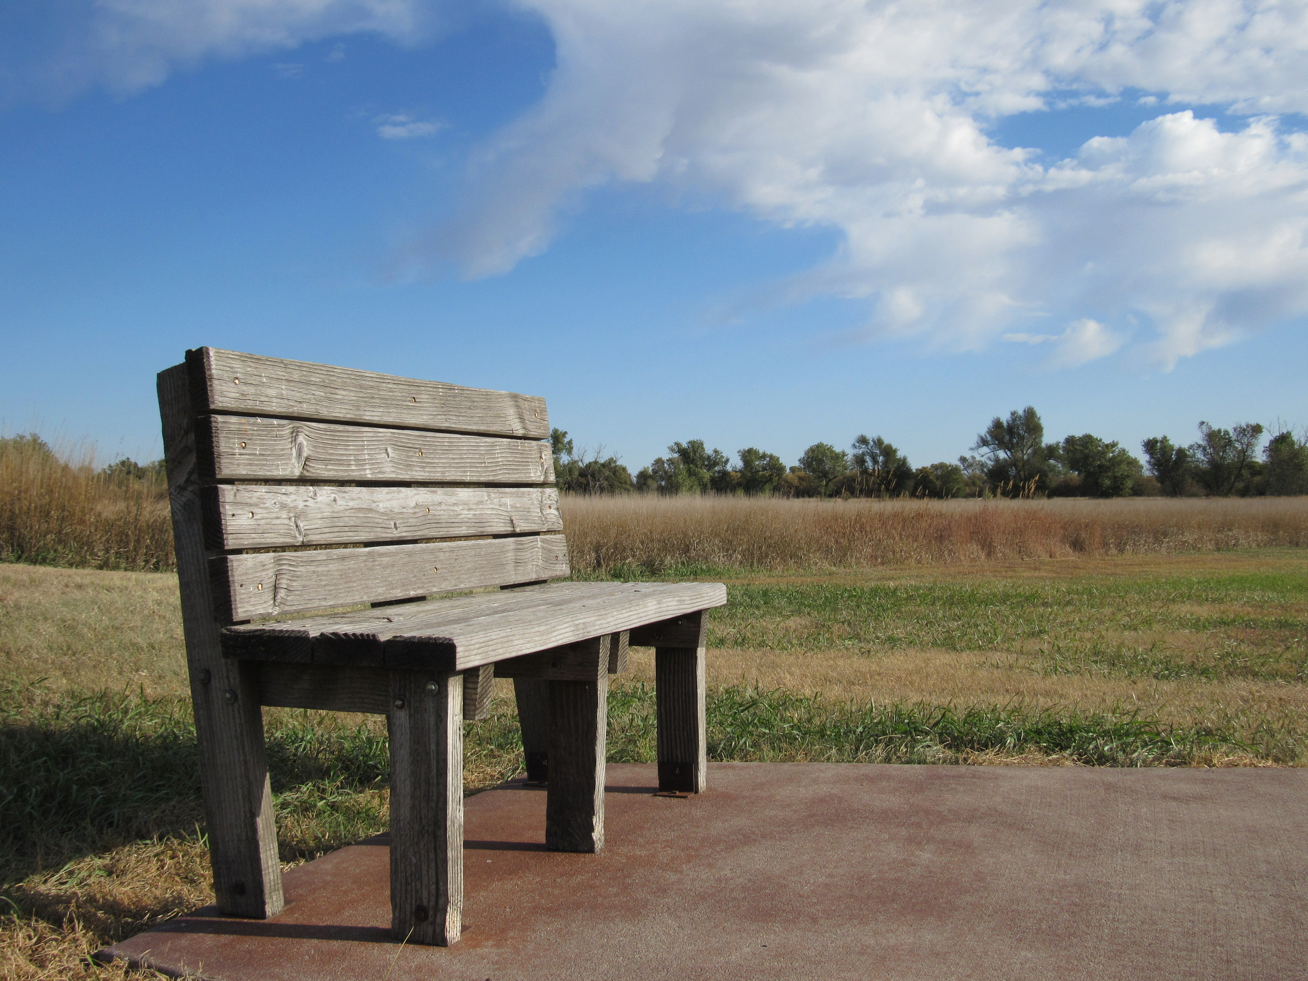
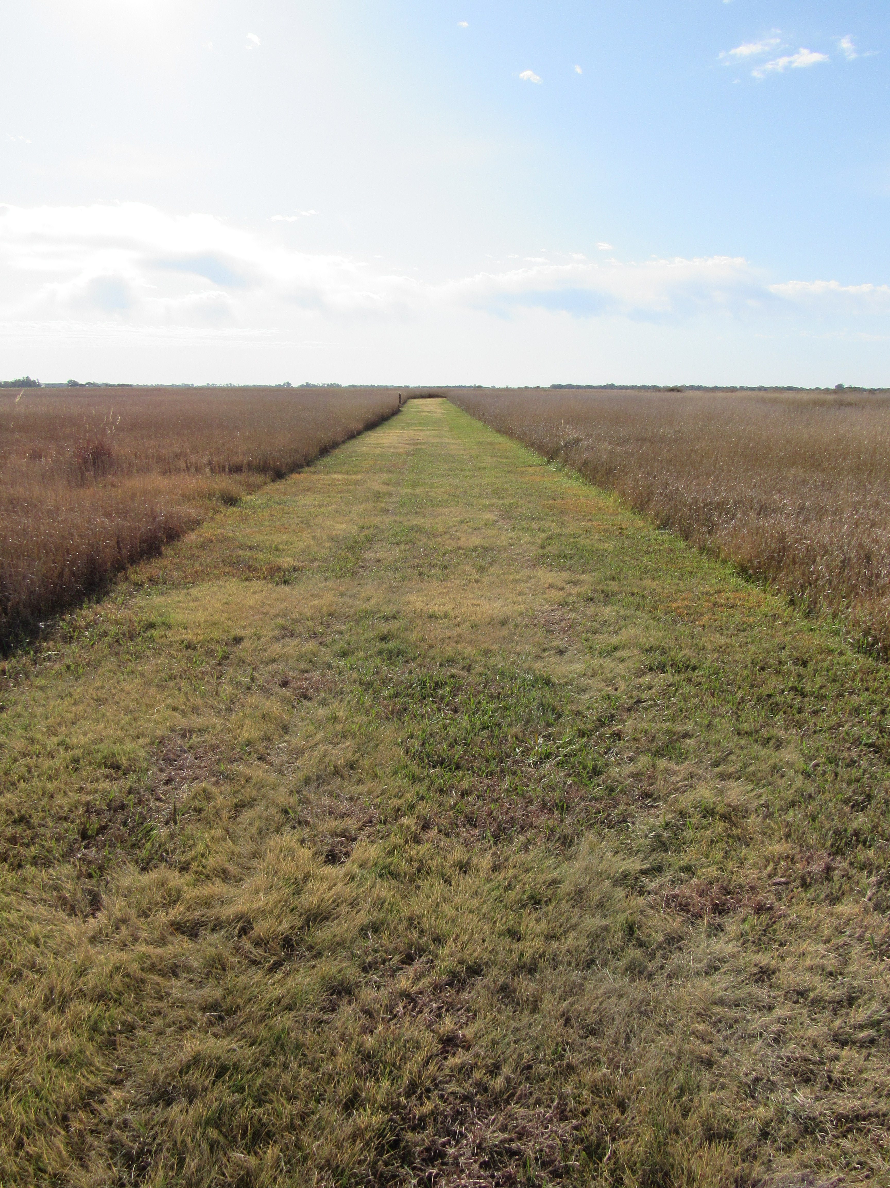
History and Nature Trail
The fort also offers a self-guided history and nature trail. At one mile in length, visitors can enjoy a hike around the grounds while using the pamphlet to highlight key areas.

Slide 16
Sources
Fort Larned NPS Site: https://www.nps.gov/fols/index.htm
Fort Larned: Guardian of the Santa Fe Trail by Leo Olivia
Fort Larned Museum at Fort Larned Historical Site

